Slide 1
JOURNEY SCRAPBOOK
FOUNDATIONAL TRAINING – WEEK 1
14 Aug’23 – 18 August’23

Slide 2
DAY 1 TOPICS COVERED
INTRODUCTION TO BUSINESS ANALYSIS
REQUITEMENTS ANALYSIS – FUNCTIONAL AND NON-FUNCTIONAL REQUIREMENTS
REQUIREMENTS TRACEABILITY
PROJECT MANAGEMENT BASICS
WATERFALL VS AGILE
SPRINT
SCRUM AND DIFFERENT ROLES IN IT

Slide 3
Learnings about Business Analysis and SDLC:
Explored the role and significance of a business analyst within an organization.
Gained insights into the Software Development Life Cycle (SDLC) and its crucial steps.
Understood how a structured SDLC enhances project management and product development.
Requirement Analysis and Types of Requirements:
Delved into the process of requirement analysis and its pivotal role in project success.
Recognized the distinction between functional and non-functional requirements.
Learned how thorough requirement analysis lays the foundation for effective software development.

Slide 4
Introduction to Waterfall and Agile Methodologies:
Explored two prominent software development methodologies: waterfall and agile.
Discussed the advantages and disadvantages of each approach.
Grasped how choosing the right methodology can impact project outcomes.
Sprints, Scrum, and Practical Activity:
Learned about sprints as time-bound development iterations within the Agile framework.
Discovered the Scrum framework as a popular Agile methodology.
Engaged in a hands-on activity involving sprint planning, daily scrum meetings, review, and retrospective.
Gained practical insight into the collaborative nature of Agile development.

Slide 5
Azure DevOps and Project Management:
Explored Azure DevOps, a widely used tool for project management and collaboration in software development.
Learned how to create and manage tasks, epics, and user stories within Azure DevOps.
Grasped the importance of efficient project management tools for streamlining development workflows.

Slide 6
DAY 2 PROJECT MANAGEMENT

Slide 7
Enabler Stories:
Enabler stories support the expansion of the Architecture Runway to accommodate future business functionality.
Following the Use Case Enabler approach in Scrum, these stories provide a foundation for upcoming features.
Examples of user stories include actions like login and adding items to a shopping cart.
Enabler story instance: Implementation of facial recognition for login.
Another enabler story: Enhancing the item-to-cart process for scalability and future improvements.
While not mandatory, these features are designed for gradual enhancement and scalability.
Story Points:
Story points quantify the effort required for completing Product Backlog Items (PBIs) or other tasks.
They serve as a unit of measurement to estimate and plan work effectively.
Definition of Ready:
The Definition of Ready outlines the prerequisites that a user story must meet before being taken up in a sprint.
It establishes the criteria that make a user story actionable for development.
Simply put, a user story needs to fulfill certain conditions before it's considered ready for sprint planning.

Slide 8
Definition of Done (DoD):
The Definition of Done represents a specific type of working agreement within a development team.
It encompasses the conditions that must be met for a user story or task to be considered complete.
Components of the Definition of Done include passing unit test cases, completion of code reviews, meeting acceptance criteria, successful functional testing, passing non-functional tests, and obtaining approval from the product owner.
KANBAN Workflow Stages:
Backlog | In Progress | Peer Review | In Test | Done | Blocked
Tasks progress through these stages in a Kanban workflow to indicate their current status.
Difference between SCRUM and KANBAN:
Timeboxing: Scrum involves timeboxed iterations (sprints) where work is planned for a fixed time. Kanban's iterations are optional and not timeboxed.
Commitment: Scrum teams commit to a specific amount of work for a sprint. In Kanban, this commitment is optional, and work is pulled based on capacity.
Burndown Chart: Scrum employs a burndown chart to track work completed over time. Kanban doesn't prescribe a specific chart.
Estimation: Scrum requires estimation of work during sprint planning. Kanban allows estimation but doesn't mandate it.
Adding Work: In Scrum, items cannot be added to an ongoing sprint. Kanban allows adding items whenever capacity is available.
Ownership: Scrum's sprint backlog is owned by a specific team. Kanban boards can be shared by multiple teams.
Reset: A Scrum board is reset after each sprint. Kanban boards are not reset; they show continuous flow.

Slide 9
Notable Project Failures:
Sony Betamax: Sony's Betamax video recording format lost to VHS due to factors like marketing, cost, and availability of content.
New Coke: The introduction of a reformulated Coca-Cola, known as New Coke, led to public backlash and a swift return to the original formula.
Product and Sprint Backlog:
Product Backlog: A list of all desired features, enhancements, and fixes for a product.
Sprint Backlog: A subset of the product backlog, containing items selected for a specific sprint.
Estimation in Agile:
Agile estimation involves determining the effort, time, scope, and cost required for completing tasks or user stories.It includes:
Estimating the amount of work involved.
Estimating the time required for completion.
Estimating the associated costs.
Estimating the effort required, often measured in personal hours.
Estimating the project's overall cost in monetary terms.
Story Points: Story points are a relative unit of measurement used for estimating the effort required to complete user stories in Agile.The process involves:
The customer presents a user story.
The development team estimates the effort needed.
The team discusses and aligns on the estimates.

Slide 10
Scrum events
The sprint
Sprint planning
Daily Scrum
Sprint review
Sprint retrospective
Two types of charts- burn-up charts & burn-down charts
Velocity Chart
It gives an estimate of how much work has been delivered for each sprint
Average of the total story points completed over a given number of sprints
*** iteration is synonymous with sprint in SCRUM
Complexity calculation in SCRUM
Complexity = Amount of Work + Degree of Risk + Level of Uncertainty

Slide 11
DAY 3 PostgreSQL

Slide 12
DBMS (Database Management System)
Data:
Represents information stored in a structured manner.
Need for DBMS:
Collectively retrieve data.
Ensure data retrieval in the required format.
Database:
Systematic storage of data.
Changes in the Database:
Manipulate data to suit requirements.
DBMS:
Facilitates changes in a database.
RDBMS (Relational DBMS):
Manipulates relational databases.
"Relational" refers to relationships existing in the data.
User Administration:
Registers and monitors users to maintain data integrity.
Three Types of Databases:
Relational Databases
Object-Oriented Databases
Distributed Databases

Slide 13
Data Warehouse:
Central repository for multiple datasets.
Enables faster querying and analysis.
Similar data grouped together.
NoSQL:
Schema-less database system.
Stores raw data efficiently.
Allows fast querying and handling large data.
Graph Database:
Represents data in a graphical format.
Example: Neo4j.
OLTP (Online Transaction Processing):Adheres to ACID properties:
Atomicity
Consistency
Isolation
Durability
SQL (Structured Query Language):
Manipulates databases.
DDL (Data Definition Language):
Creates, alters, drops, truncates.
DQL (Data Query Language):
Performs SELECT queries.
DML (Data Manipulation Language):
Executes INSERT, UPDATE, DELETE operations.
DCL (Data Control Language):
Manages permissions with GRANT and REVOKE.
TCL (Transaction Control Language):
Handles transactions with COMMIT, ROLLBACK, SAVEPOINT, SET TRANSACTION.

Slide 14
Normalization:
Process to organize data efficiently.
1NF: No multi-valued attributes.
2NF: No dependencies among columns.
Joins:
Combines data from different tables.
Types: INNER, OUTER (LEFT, RIGHT, FULL), CROSS.

Slide 15
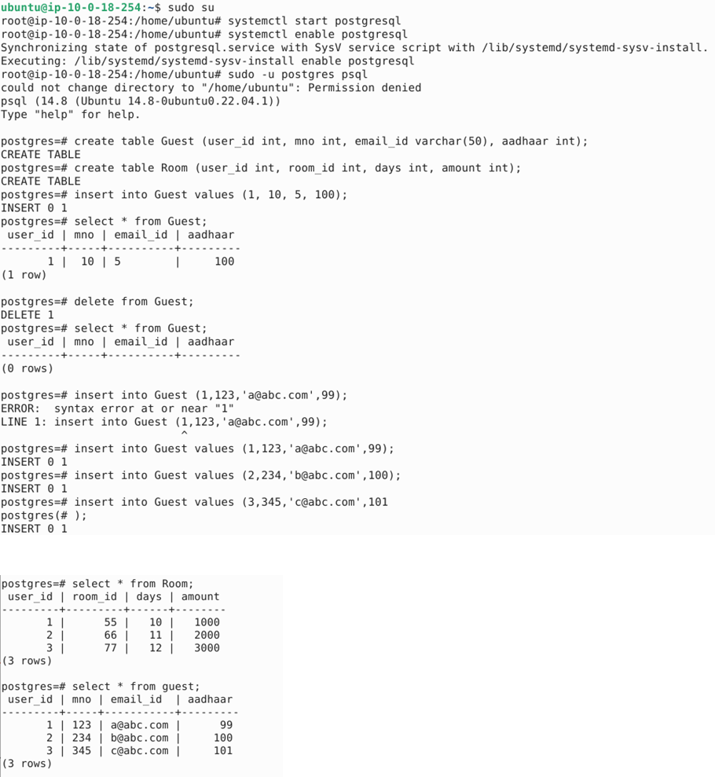

Slide 16
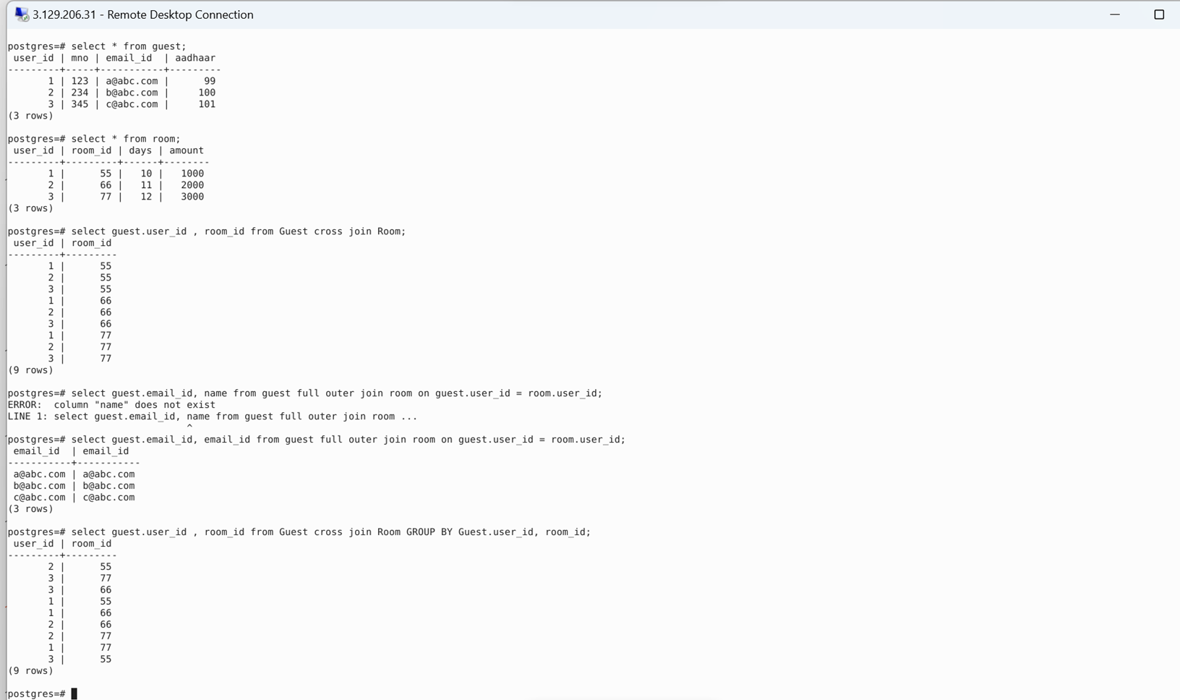

Slide 17
DAY 4 TESTING

Slide 18
Testing Process:
Requirement Analysis
High-Level Design
Low-Level Design
Coding
Integration Testing
System Testing
Production
Test Data:
Dummy data used for creating test cases.
Types of Testing:
White Box: Unit testing.
Black Box: Functional testing.
Gray Box: Automation testing.
Need for Testing:
Ensure the product meets requirements.
Verify product consistency.
Confirm adherence to safety standards.
Types of Functional Testing:
Unit Testing
System Testing
Integration Testing
Regression Testing
Smoke Testing
Sanity Testing
Ad hoc Testing
End-to-End Testing

Slide 19
Types of Non-Functional/Performance Testing:
Load Testing
Stress Testing
Software Testing Lifecycle:
Test Strategy
Test Planning
Test Design
Test Environment Setup
Test Execution
Defect Reporting
Test Closure
Defect Lifecycle:
New -> Active (possibly defer) -> Resolve -> Close
Testing Deliverables:
Test Strategy: Word Document
Test Plan: Word Document
Test Design: Test Case
Test Environment Setup: QA Environment
Test Execution: Pass/Fail Statistics
Defect Report: Severity Indication
Test Closure: Test End Summary Report
Testing Triangle:
UI Exploratory Testing
Integration Testing
Unit Testing

Slide 20
DAY 5 TESTING

Slide 21
DevOps Process:
Local Development
Central Development
Testing
Pre-Production (Staging)
Production
Why DevOps:
Accelerate software delivery.
Increase revenue for business stakeholders.
DevOps Purpose:
Bridging the gap between development and operations.
DevOps Lifecycle:
Continuous Development
Continuous Integration
Continuous Testing
Continuous Deployment
Continuous Monitoring
Continuous Feedback
Continuous Operations
DevOps Principles:
Automation
Iteration
Continuous Improvement
Collaboration
Benefits of DevOps:
Faster project deployment
Increased revenue
Greater stakeholder value
Enhanced efficiency
Improved collaboration
Reduced risks
Continuous Integration (CI):
Merging devops changes into a central repository.
Automation and testing of code.
Principles:
Revision control
Automated testing
Build automation

Slide 22
Continuous Delivery:
Automated deployment of code changes to testing and/or production environments.
Continuous Deployment:
Immediate release of every code change that passes through all production pipeline stages.
GitHub Actions:
CI/CD platform for automating workflows.
GitHub Actions Components:
Workflow
Events
Jobs
Actions
Runners

Slide 23
DAY 6 GITHUB WORKFLOW & CLOUD COMPUTING

Slide 24
Steps are as follows:
Create a new repo
Inside the repo, go to actions
Create a simple workflow
Add a file in .yaml format
Add a sample code from github docs
Commit changes whenever required
Return all jobs after going to actions again

Slide 25
Cloud Computing:
Network of systems globally providing storage and processing services on a pay-as-you-go basis.
Service Models:
IaaS (Infrastructure as a Service): Offers virtualized computing resources over the internet.
SaaS (Software as a Service): Provides software applications via the internet.
PaaS (Platform as a Service): Offers a platform for developers to build, deploy, and manage applications
Disadvantages of Cloud Computing:
Dependency on internet connectivity.
Concerns about security and privacy.
Costs for limited services or negligence.
Ownership and control of data.
Virtualization:
Enables multiple software instances to run on the same system.
Reduces costs of maintaining separate systems for different operating systems.

Slide 26
Thank you
Radhika Tibrewal
Radhika.Tibrewal@shell.com

